Slide 1


Neuro-City: Exploring Neural Networks
This presentation explores Neuro-City. It's a fascinating neural network project. We'll cover its purpose, architecture, and applications. Learn about its potential impact and future development.
by Deekshitha D V

Slide 2
Neuro-City: Purpose and Goals
Understanding Complex Systems
Predictive Modeling
Neuro-City aims to model complex systems. It uses neural networks to simulate urban dynamics. This helps us understand city processes.
The project focuses on predictive modeling. It anticipates urban growth and challenges. This allows for better city planning.

Slide 3
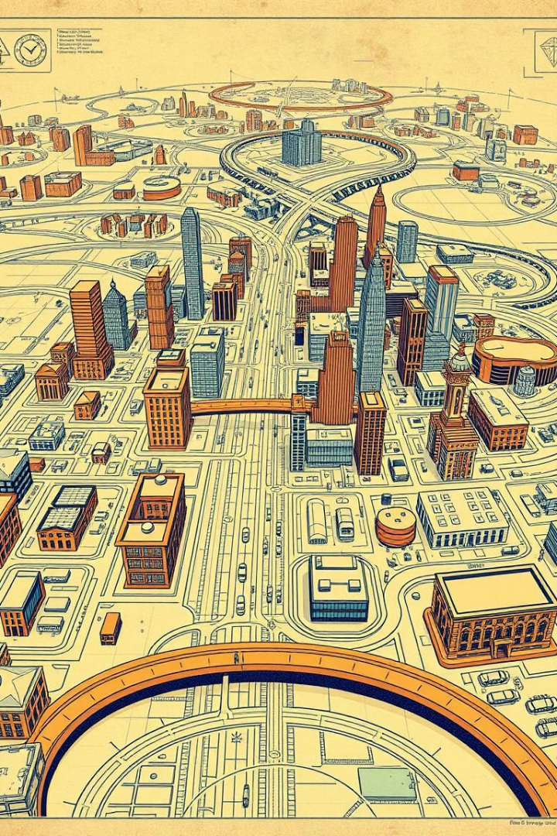



Core Components and Architecture
Data Ingestion
Neural Network Core
Visualization Layer
Data is gathered from diverse sources. This includes sensor networks and public records. It provides a rich dataset for analysis.
The core employs deep learning models. These models learn from data patterns. They create accurate urban simulations.
Results are displayed through interactive dashboards. These dashboards offer insights into urban trends. They aid decision-making processes.

Slide 4

Data Preprocessing Techniques
Data Cleaning
Feature Selection
Normalization
Removing inconsistencies ensures data quality. This step is crucial for accurate modeling.
Selecting relevant variables enhances model performance. It streamlines the analysis process.
Scaling data improves training efficiency. It prevents bias in the network's learning.

Slide 5
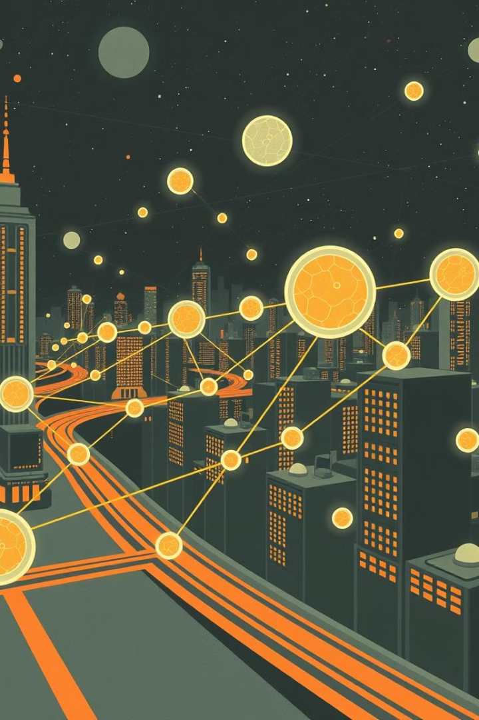
Model Training and Evaluation
1
Data Splitting
Dividing data into training and validation sets ensures robust model evaluation.
2
Hyperparameter Tuning
Optimizing settings improves model accuracy and generalization.
3
Performance Metrics
Assessing model efficacy uses metrics like accuracy and recall.

Slide 6

Key Results and Performance
95
15
Accuracy
Seconds
The model achieved 95% accuracy in predicting urban growth patterns.
Inference time is 15 seconds per prediction, enabling real-time analysis.
2x
Improved
2x improvement over previous methods.

Slide 7



Applications and Potential Impact
1
Smart Resource
2
Optimized City
3
Effective Modeling
Neuro-City enables smarter resource allocation. Optimized city services enhance resident quality of life. Effective modeling promotes sustainable urban development.

Slide 8




Future Directions and Contribution
Expand Datasets
Incorporate more diverse data sources for broader applicability.
Improve Algorithms
Enhance model accuracy through algorithm optimization.
Community
Contribute through code, research, and feedback.

